Slide 1



Python Programming
Lecture 24: HTTP Methods

Slide 2

The Problem with Large-Scale APIs
Single File Management Issues
Example Analogy
Imagine a departmental store with all products piled together
Having hundreds of API endpoints in one file is unmanageable
Difficulty in organizing and maintaining the code
Solution
Use routers to divide the APIs into manageable sections

Slide 3



Organizing APIs with Routers
The Router Analogy
Think of routers like sections in a departmental store
Instead of browsing through piles of items, routers guide you directly to specific sections (APIs)
Key Benefit
Better organization and smoother management

Slide 4



What Are API Routers?
Definition of Routers
Why Routers
Implementation
In FastAPI, routers allow you to group related endpoints together
Organize your code into logical modules
Create a router instance and define specific routes for each group
Improve scalability and maintainability

Slide 5
The FastAPI Router Setup
1
Import APIRouter from FastAPI
2
Define Router Instance
3
Set Up Routes
4
Organize by Function
Define routes using the @router.get, @router.post decorators
Create an instance of APIRouter to organize your endpoints
Organize APIs by function or resource (e.g., items, users, orders)
First step is to import the necessary components from the FastAPI library

Slide 6





Main Application (Main Router)
Main Gate
Acts like the main gate of a store
Direction
Routes customers to the appropriate section (router) based on their request
Implementation
Use app.include_router() to link the main app with specific routers
Result
Allows modular design for large projects

Slide 7


Restaurant Analogy for FastAPI Routers
One Chef Approach
Multiple Chefs Approach
A single chef handling all orders is inefficient
Head chef and specialized assistant chefs (routers for different sections)
Similar to having all API endpoints in one file
Each chef handles specific types of dishes
Leads to confusion and slower service
Faster and more organized service, similar to how routers handle API endpoints

Slide 8




FastAPI Router Code Example
Define Main App
Import Routers
Include Routers
Access Endpoints
Import router modules from different files
app.include_router(items_router, prefix="/items", tags=["items"])
Create your main FastAPI application
The /items/ endpoint will automatically route to the item-related APIs

Slide 9

Breakdown of the (main_shop_app.py)
Key Components
APIs in Main File
Import FastAPI and routers
Basic home and about pages to introduce the app
Create an app instance and include routers
Example
@app.get("/") for the home page

Slide 10



Setting Up Item Router (shop_items_router.py)
Item Router
Code Overview
Why Separate Files?
Separate file for item-related operations (GET, POST)
Define a router for item operations using @router.get(), @router.post()
Easy to manage and scale with large numbers of APIs

Slide 11



How Routers Are Included in Main Application
Import Routers
Connect with include_router
Access APIs
Import router modules into main application
All item-related APIs are now accessible via /items/ in the main app
app.include_router(items_router, prefix="/items", tags=["Shop Items"])

Slide 12
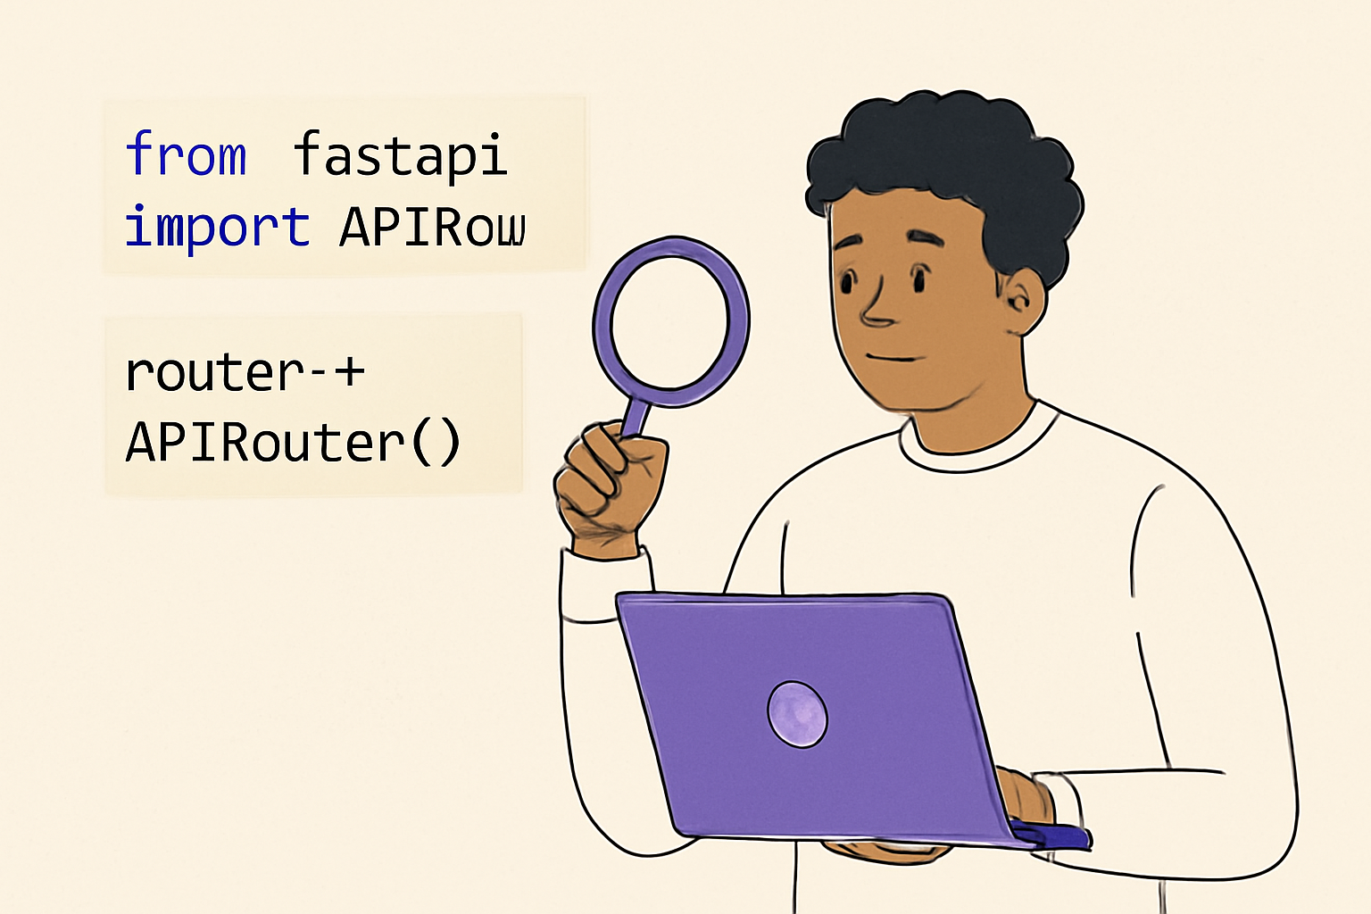




Exploring the items_router.py File
Import Components
Define Router
Import necessary components from FastAPI
Define the APIRouter() instance
Set Up Endpoints
Example Endpoint
Set up item-related endpoints
@router.get("/") for retrieving all items

Slide 13
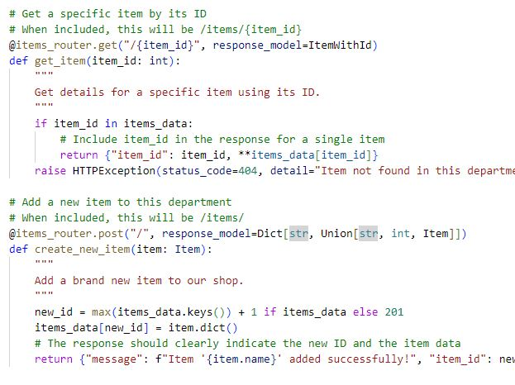
Running the Main Shop App
How to Run
What to Expect
Execute main-shop-app.py to launch the FastAPI app
Access the main page and item APIs in the browser
Documentation
Try the interactive documentation at /docs

Slide 14
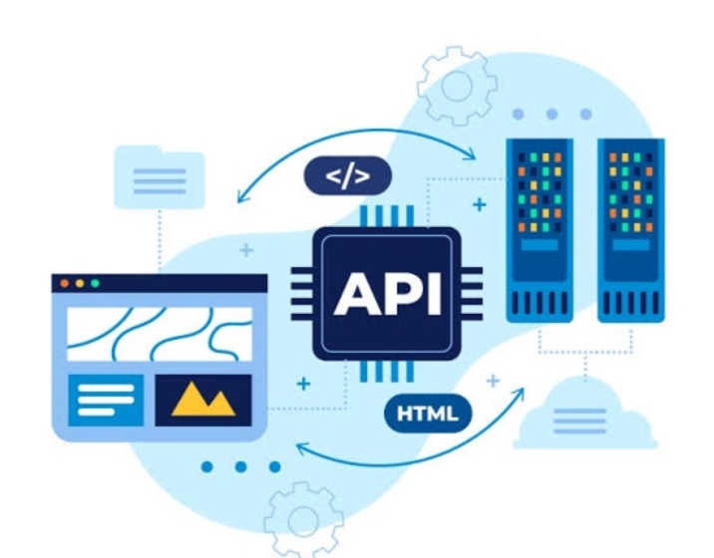

Testing API Endpoints
API Testing
Use the browser or tools like Postman to test GET and POST requests
Example
Test creating an item with POST /items/
View all items with GET /items/

Slide 15
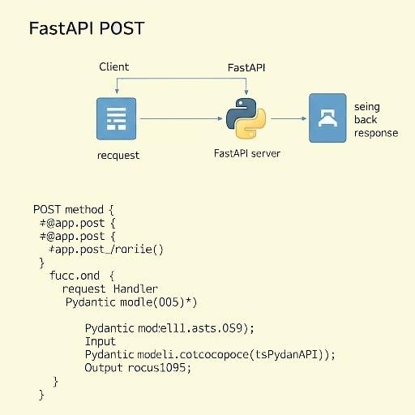




Using the POST Method to Add Items
Adding New Items
POST request allows adding new items to the store
Example
Create a new item (e.g., laptop) and assign it an automatically generated ID
Result
The response shows the new item and its ID

Slide 16
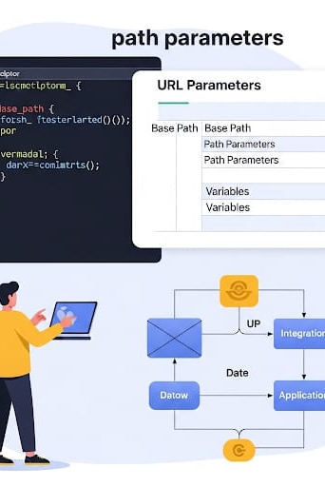



Working with Path Parameters
Define Path Parameter
Pass specific item IDs in the URL (e.g., /items/{item_id})
Code Implementation
@app.get("/items/{item_id}")
Retrieve item data by ID
Automatic Validation
FastAPI handles path parameter validation automatically

Slide 17
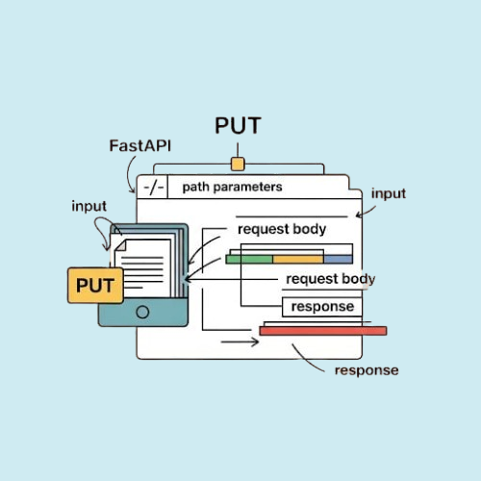
PUT Method for Updating Items
Updating Items
Example
PUT request updates an existing item
Update item details like name and price using the item ID
Test
Try updating an item with a PUT request

Slide 18
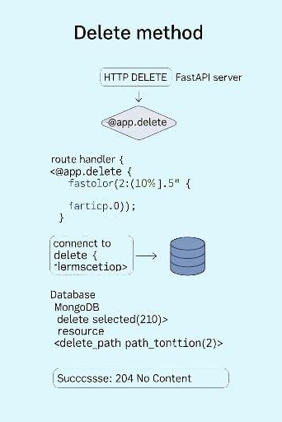



DELETE Method for Removing Items
Deleting Items
Example
DELETE request removes an item from the database
Delete an item by providing its ID in the URL
Test
Execute DELETE request and verify item removal

Slide 19
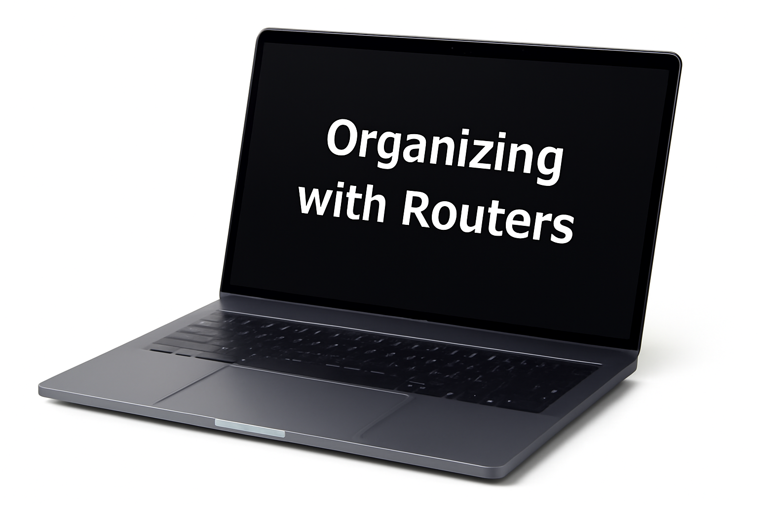


Benefits of Organizing with Routers
Improved Code Manageability
Keep different features (items, users) in separate modules
Easily scale your project by adding more routers
Easier Maintenance
Isolate problems and updates to specific modules

Slide 20



Conclusion and Next Steps
Key Takeaways
Routers help organize and manage APIs in FastAPI
Path parameters, GET, POST, PUT, DELETE methods are essential tools for building web APIs
Next Steps
Practice creating your own routers and endpoints
Continue exploring FastAPI's powerful features in the upcoming project

